Slide 1
Oil price
Prediction
TEAM :- 3
ABHISHEK
SHALINI
VISHAL
LILLY
SATISH KUMAR

Slide 2
OBJECTIVE :-
.
Oil is a product that goes completely in a different direction for a single market event as
the oil prices are rarely based on real-time data, instead, it is driven by externalities making
our attempt to forecast it even more challenging.
As the economy will be highly affected by oil prices our model will help to understand the
Pattern in prices to help the customers and businesses to make smart decisions.
The objective of the analysis is to predict the price of the oil and to emphasize the need for a reliable model that can understand price patterns. This model aims to help customers and businesses make smart decisions considering the significant impact of oil prices on the economy.

Slide 3
PROJECT ARCHITECTURE
Data Collecting
Data Processing
EDA & Visualization
Model Building
Model Evaluation
Prediction
Forecast Visualization
Deployment

Slide 4
DATA SUMMARY
The dataset is of excel file :- Crude Oil Prices
Oil dataset.
Date
Closing Value
Shape of dataset :- (8223,3)

Slide 5
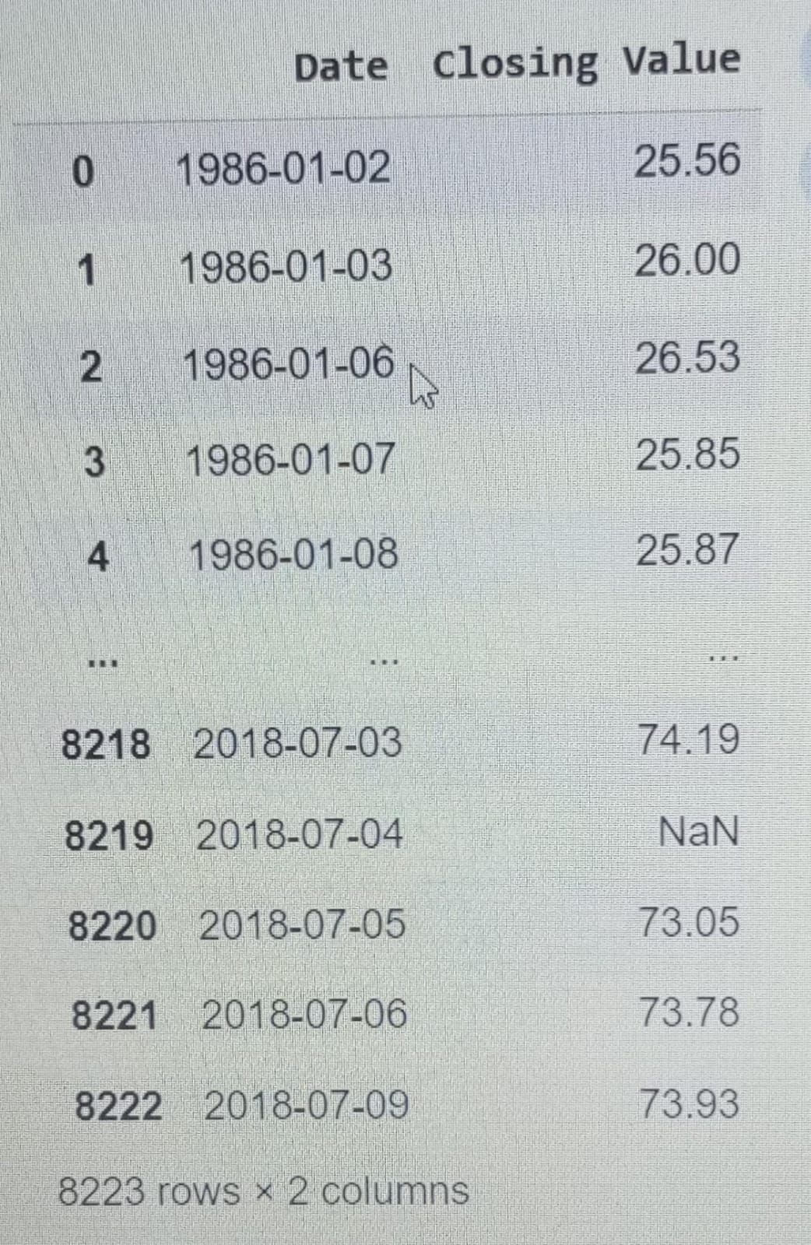
Loading the data
data = pd.read_excel("Crude Oil Prices Daily.xlsx")
data

Slide 6
INDEX POSITION:
DatetimeIndex(['1986-01-02', '1986-01-03', '1986-01-06', '1986-01-07', '1986-01-08', '1986-01-09', '1986-01-10', '1986-01-13', '1986-01-14', '1986-01-15’........
'2018-06-26', '2018-06-27', '2018-06-28', '2018-06-29', '2018-07-02', '2018-07-03', '2018-07-04', '2018-07-05', '2018-07-06', '2018-07-09’])
Start data of the data is 1986-01-02
End data of the data is 2018-07-09

Slide 7
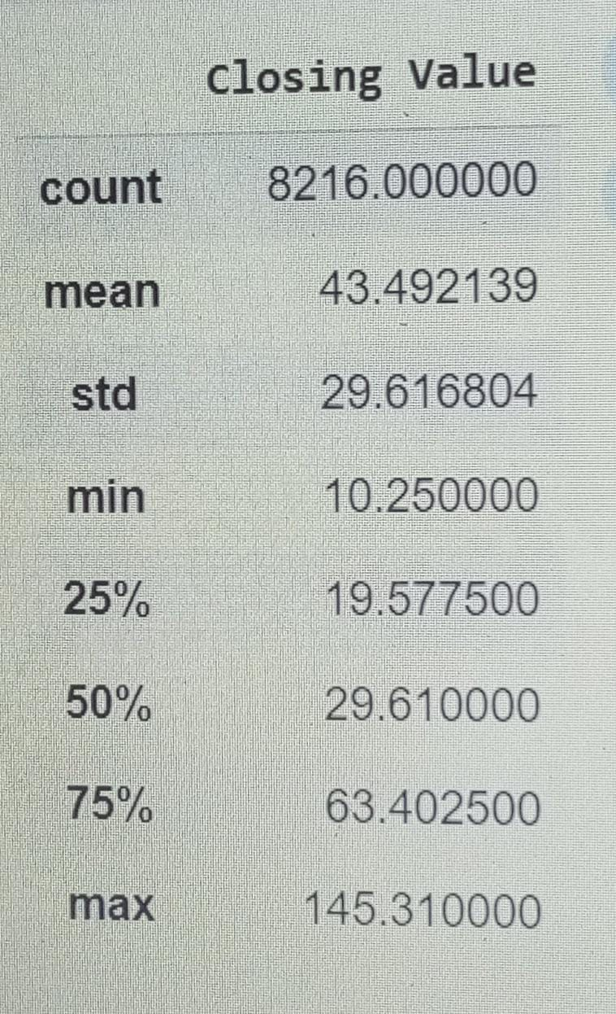
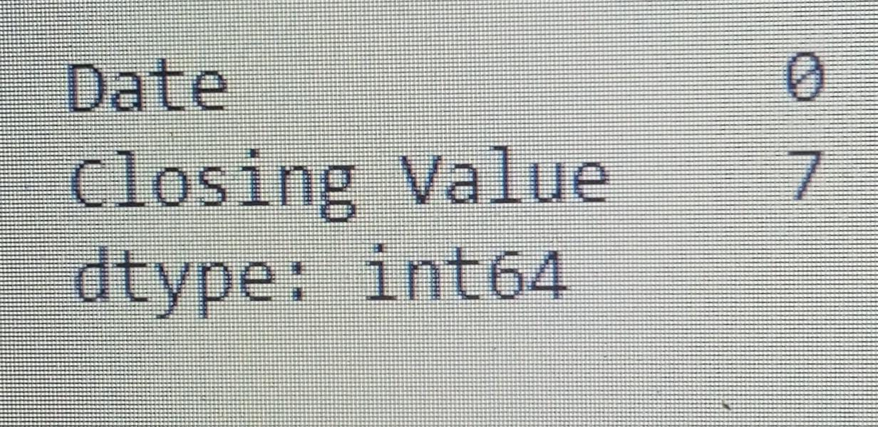
DATA CLEANING
data.describe()
data.isnull().sum()

Slide 8
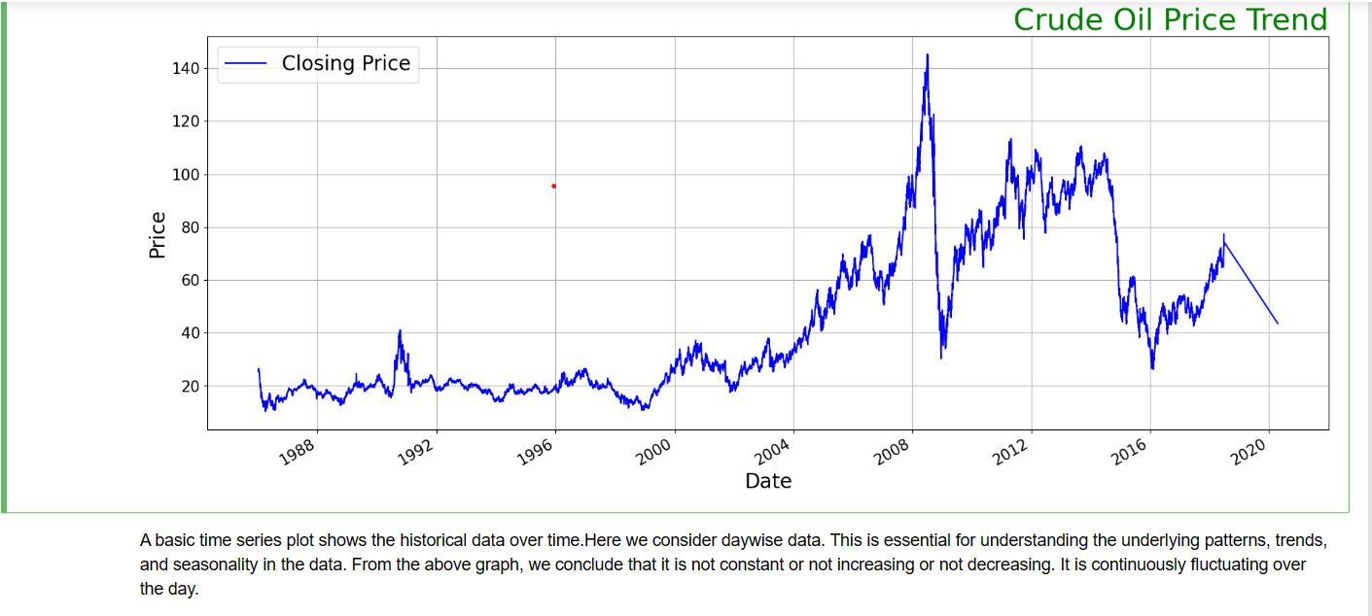
Plot the historical oil prices to get an initial understanding of the trends and patterns in the Data

Slide 9
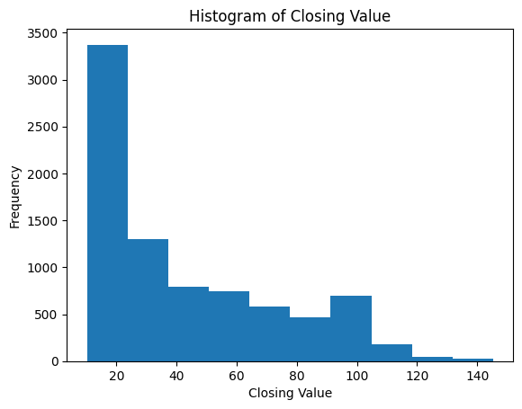
Histogram of Closing Value

Slide 10
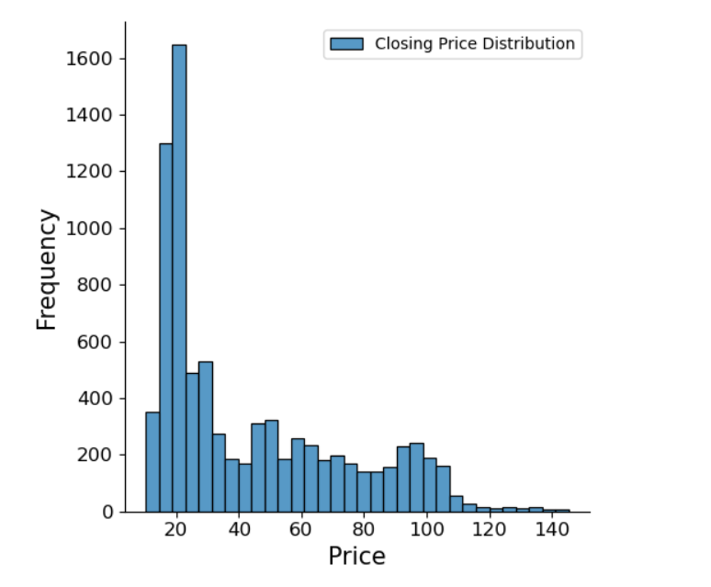
Plot Displot Which Shows Price Data Distribution

Slide 11
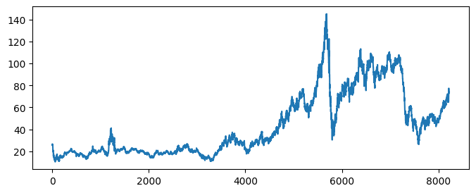
Line Plot Of The Data.

Slide 12
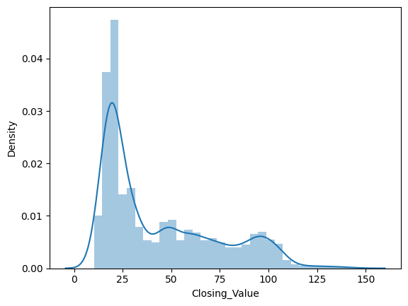
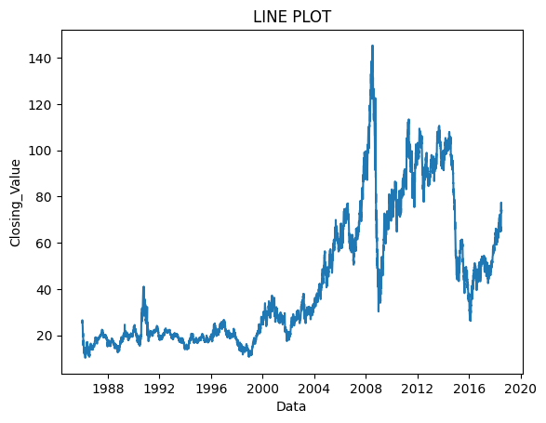
Distribution plot of closing value
Line Plot of Date and Closing Value
The line plot tells that in 2009 the oil price is higher .

Slide 13
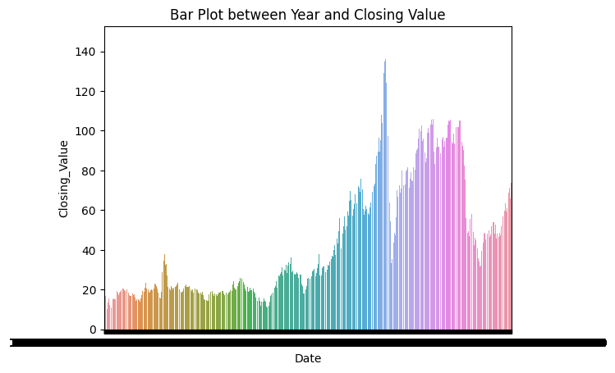
Bar Plot Between Date And Closing Value.

Slide 14
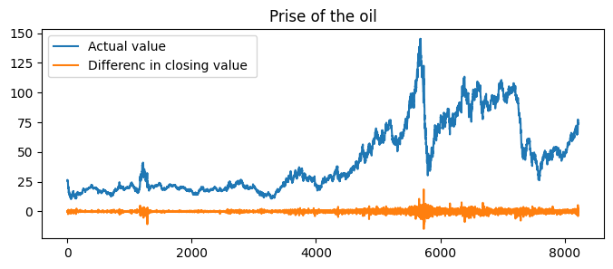
Price Of Oil with actual value and difference in closing value
ACF is a statistical measure used in time series analysis to describe the correlation between a variable
and its past values.

Slide 15
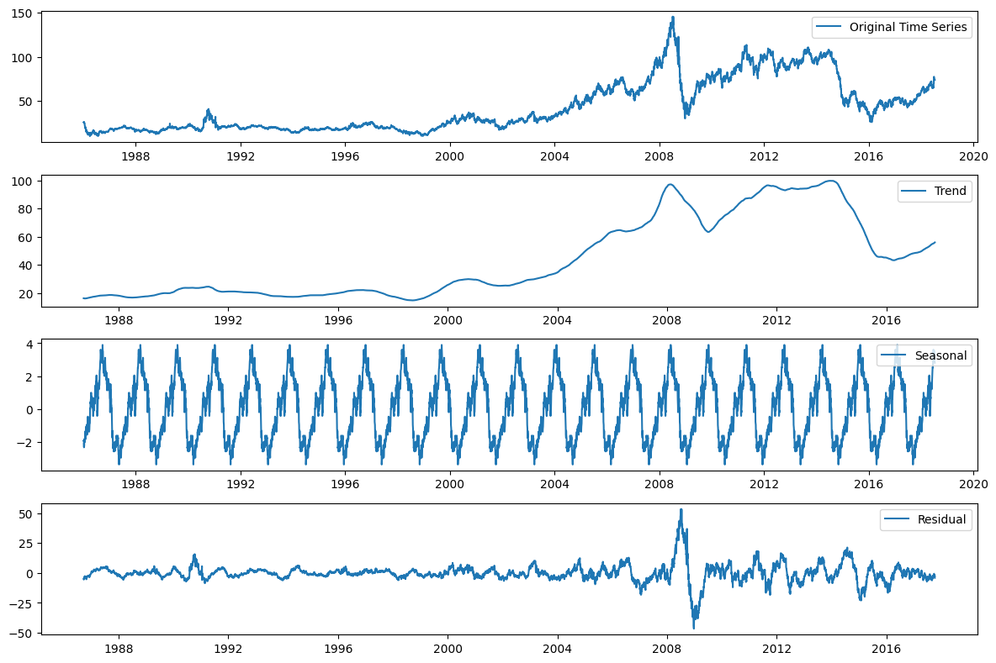
Plotting The Original Time Series, Trend, Seasonal, And
Residual Components.

Slide 16
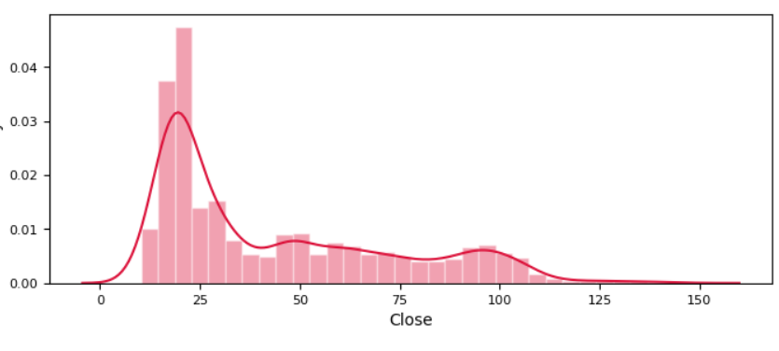
Plot distpot which depicts the variation in the datadistribution

Slide 17
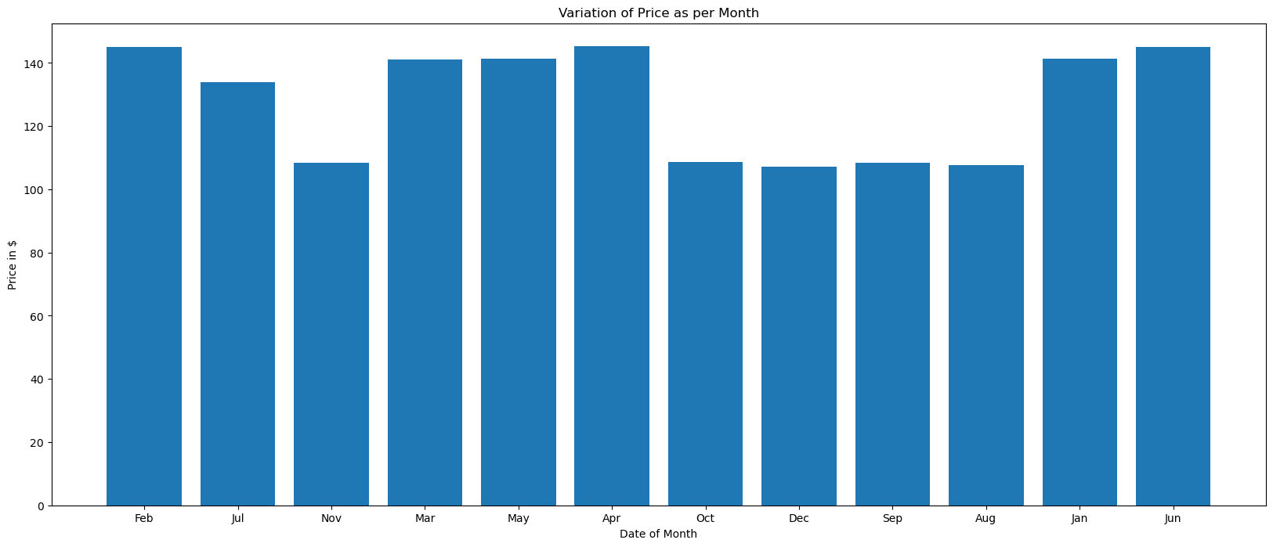
Variation of Price as per Month

Slide 18
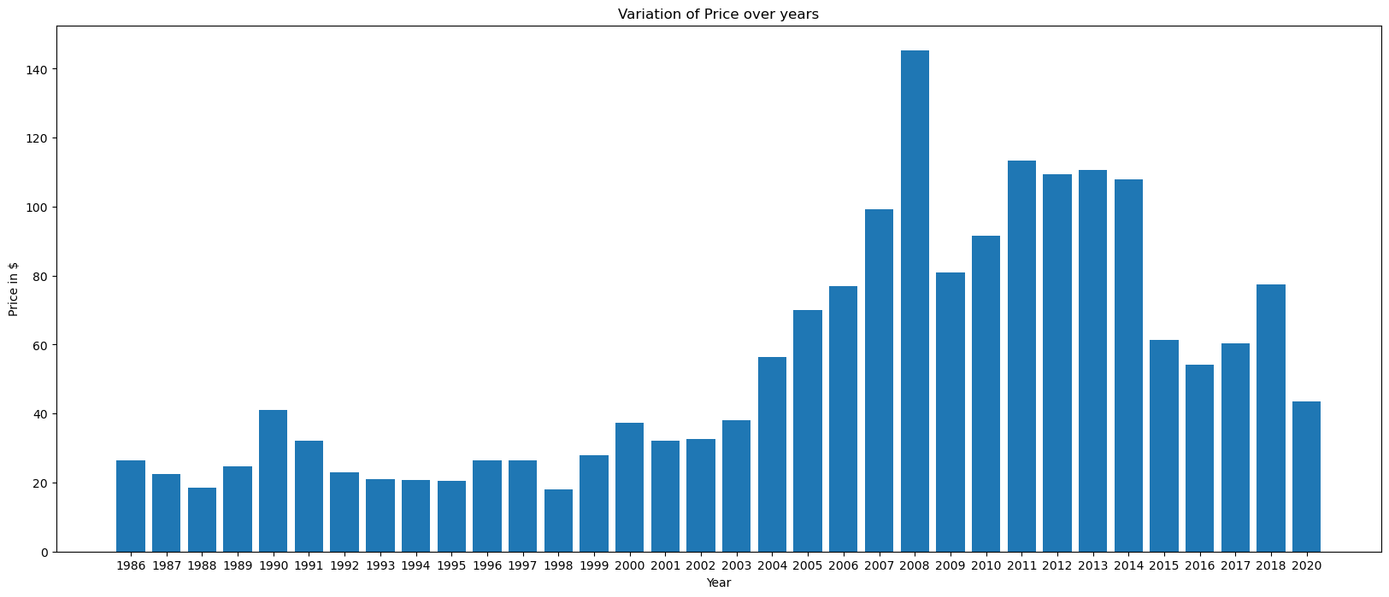
Variation of Price over years

Slide 19
Autocorrelation Function (ACF)
The Pearson’s correlation coefficient is a number between -1 and 1 that describes a negative or positive correlation respectively. A value of zero indicates no correlation.
I calculate the correlation for time series observations with observations with previous time steps, called lags. Because the correlation of the time series observations is calculated with values of the same series at previous times, this is called a serial correlation, or an autocorrelation.
A plot of the autocorrelation of a time series by lag is called the AutoCorrelation Function, or the acronym ACF. This plot is sometimes called a correlogram or an autocorrelation plot.

Slide 20
Partial AutoCorrelation Function (PCAF)
In time series analysis, the partial autocorrelation function (PACF) gives the partial correlation of a stationary time series with its own lagged values, regressed the values of the time series at all shorter lags. It contrasts with the autocorrelation function, which does not control for other lags.
A partial autocorrelation is a summary of the relationship between an observation in a time series with observations at prior time steps with the relationships of intervening observations removed.

Slide 21
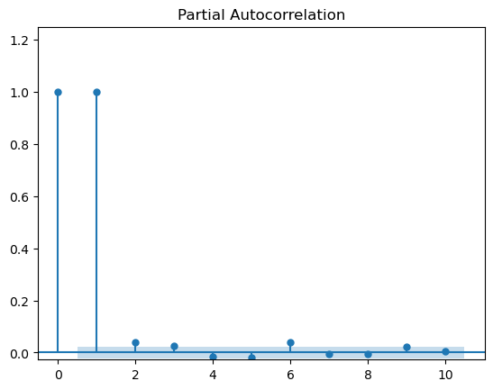
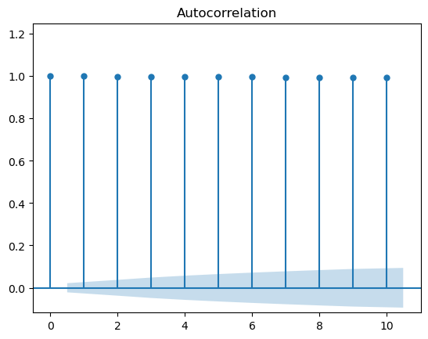
ACF and PACF plot

Slide 22
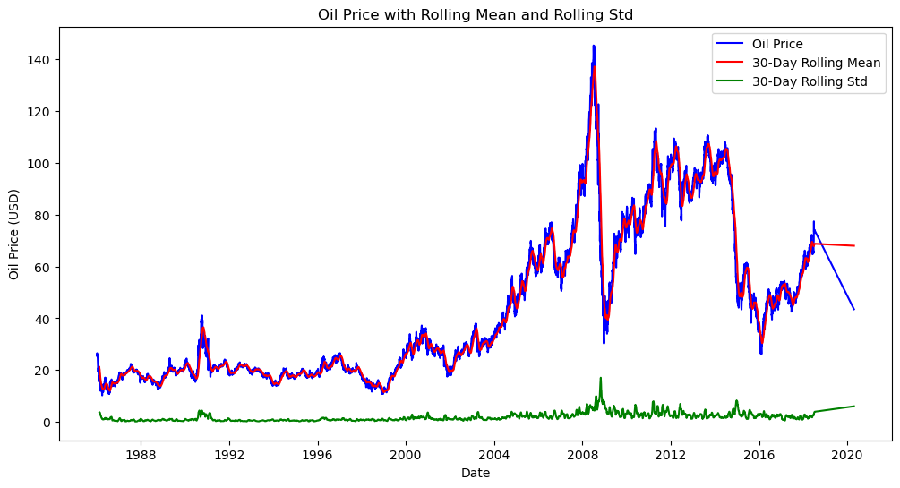
Rolling Mean AND Rolling Std

Slide 23
Make a Time Series Stationary
There are 2 major reasons behind non-stationary of a TS:
Trend – varying mean over time. For eg, in this case we saw that on average, the oil prices are growing over time.
Seasonality – variations at specific time-frames.
A p-value below a threshold (such as 5% or 1%) suggests we reject the null hypothesis (stationary), otherwise a p-value above the threshold suggests we accept the null hypothesis (non-stationary).
*p-value > 0.05: * Accept the null hypothesis (H0), the data has a unit root and is non-stationary.
*p-value <= 0.05: * Reject the null hypothesis (H0), the data does not have a unit root and is stationary.

Slide 24
Check if data is stationary or not- Not Stationary
Log transformation
Difference transformation
ADF Statistic: -12.476835373523812
p-value: 3.1546381248643405e-23
Critical Values: {'1%': -3.4311497742409274,
'5%': -2.8618934439742927,
'10%': -2.5669581334442495}
ADF Statistic: -34.60047463669875 p-value: 0.0
Critical Values:
{'1%': -3.4311470447796366,
'5%': -2.86189223790612,
'10%': -2.566957491442524}
Data is likely stationary
Data is stationary

Slide 25
LSTM MODEL
Long Short-Term Memory (LSTM) is a type of Recurrent Neural Network (RNN) that is specifically designed to handle sequential data, such as time series, speech, and text. LSTM networks are capable of learning long-term dependencies in sequential data, which makes them well suited for tasks such as language translation, speech recognition, and time series forecasting.
The basic difference between the architectures of RNNs and LSTMs is that the hidden layer of LSTM is a gated unit or gated cell. It consists of four layers that interact with one another in a way to produce the output of that cell along with the cell state. These two things are then passed onto the next hidden layer. Unlike RNNs which have got only a single neural net layer of tanh, LSTMs comprise three logistic sigmoid gates and one tanh layer. Gates have been introduced in order to limit the information that is passed through the cell. They determine which part of the information will be needed by the next cell and which part is to be discarded. The output is usually in the range of 0-1 where ‘0’ means ‘reject all’ and ‘1’ means ‘include all’.

Slide 26
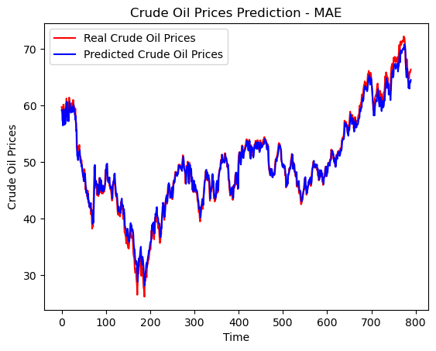
MODEL BUILDING:LSTM MODEL
rsme-lstm:
1.2281889902071457
mae-lstm:
0.9519408949839916

Slide 27
Autoregressive Integrated Moving Average(ARIMA)
ARIMA is an acronym for “autoregressive integrated moving average.” It's a model used in statistics and econometrics to measure events that happen over a period of time. The model is used to understand past data or predict future data in a series.
ARIMA is a method for forecasting or predicting future outcomes based on a historical time series. It is based on the statistical concept of serial correlation, where past data points influence future data points.
ARIMA models are a popular and powerful tool for forecasting time series data, such as sales, prices, or weather. ARIMA stands for AutoRegressive Integrated Moving Average, and it captures the patterns, trends, and seasonality of the data using a combination of past values, differences, and errors.

Slide 28
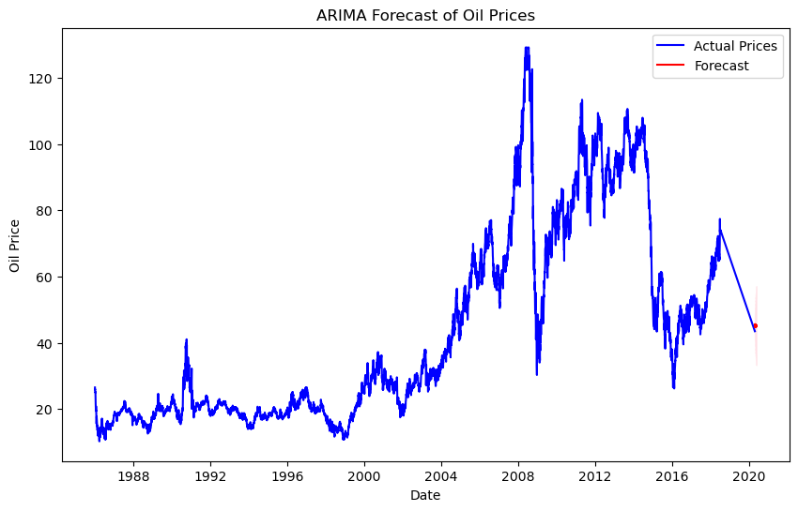
ARIMA MODEL
RMSE: 23.62872458433875

Slide 29
Holt-winters model
The Holt-Winters method is a very common time series forecasting procedure capable of including both trend and seasonality. The Holt-Winters method itself is a combination of 3 other much simpler components, all of which are smoothing methods:
Simple Exponential Smoothing (SES): Simple exponential smoothing assumes that the time series has no change in level. Thus, it can not be used with series that contain trend, seasonality, or both.
Holt’s Exponential Smoothing (HES): Holt’s exponential smoothing is one step above simple exponential smoothing, as it allows the time series data to have a trend component. Holt’s exponential smoothing is still incapable of cope with seasonal data.
Winter’s Exponential Smoothing (WES): Winter’s exponential smoothing is an extension to Holt’s exponential smoothing that finally allows for the inclusion of seasonality. Winter’s exponential smoothing is what is referred to as the Holt-Winters method.
The Holt-Winters method therefore is often referred to as triple exponential smoothing, as it is literally the combination of 3 smoothing methods built on top of each-other.

Slide 30

Holt-winters model
RMSE: 23.701450901462923

Slide 31

Holts/Double Exponential Method
RSME:23.66224366714792

Slide 32
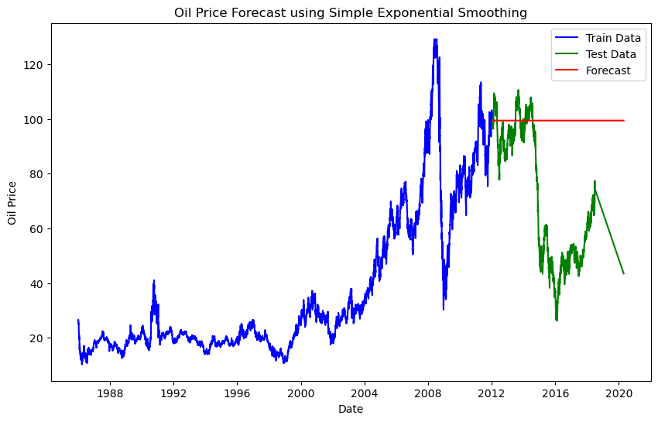
Simple Exponential Smoothing
RMSE: 37.66563319278634

Slide 33
Support Vector Regression
Support Vector Machine (SVM) is a powerful machine learning algorithm used for linear or nonlinear classification, regression, and even outlier detection tasks. SVMs can be used for a variety of tasks, such as text classification, image classification, spam detection, handwriting identification, gene expression analysis, face detection, and anomaly detection. SVMs are adaptable and efficient in a variety of applications because they can manage high-dimensional data and nonlinear relationships.
SVM algorithms are very effective as we try to find the maximum separating hyperplane between the different classes available in the target feature.
Advantages of SVM
Effective in high-dimensional cases.
Its memory is efficient as it uses a subset of training points in the decision function called support vectors.
Different kernel functions can be specified for the decision functions and its possible to specify custom kernels.

Slide 34
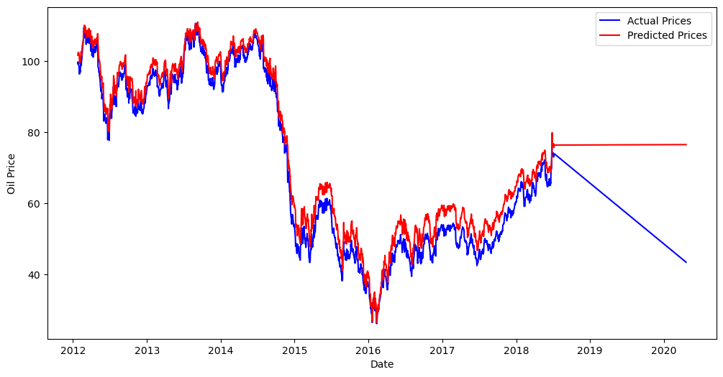
Support Vector Regression
RMSE: 0.03575222840272147

Slide 35
Prophet Model
Prophet is an open-source tool from Facebook used for forecasting time series data which helps businesses understand and possibly predict the market. It is based on a decomposable additive model where non-linear trends fit with seasonality, it also takes into account the effects of holidays

Slide 36
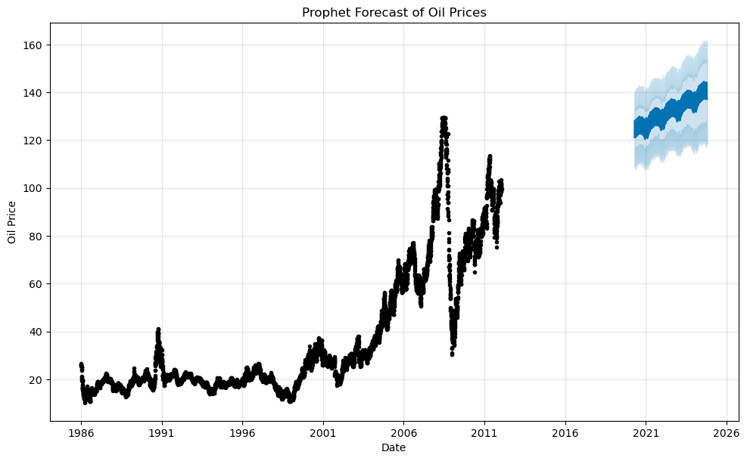
Prophet Model
RMSE: 23.698703698836184

Slide 37
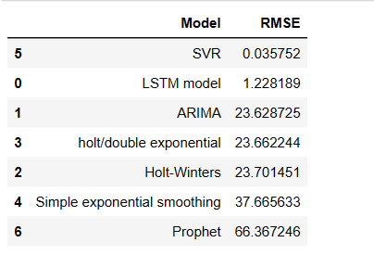
MODEL-RSME VALUES
From the above table we get low RMSE value for SVR model but we are not going to use this model because the relationship between oil prices and influencing factors (like geopolitical events, economic indicators, etc.) can be highly complex and may require more sophisticated models to capture intricate patterns. SVR may not scale well with large datasets due to its computational complexity, especially when dealing with a high number of data points or features.SVR may struggle to capture complex seasonal and trend patterns that are commonly present in time series data.SO we are going to use LSTM model for our model deployment.

Slide 38
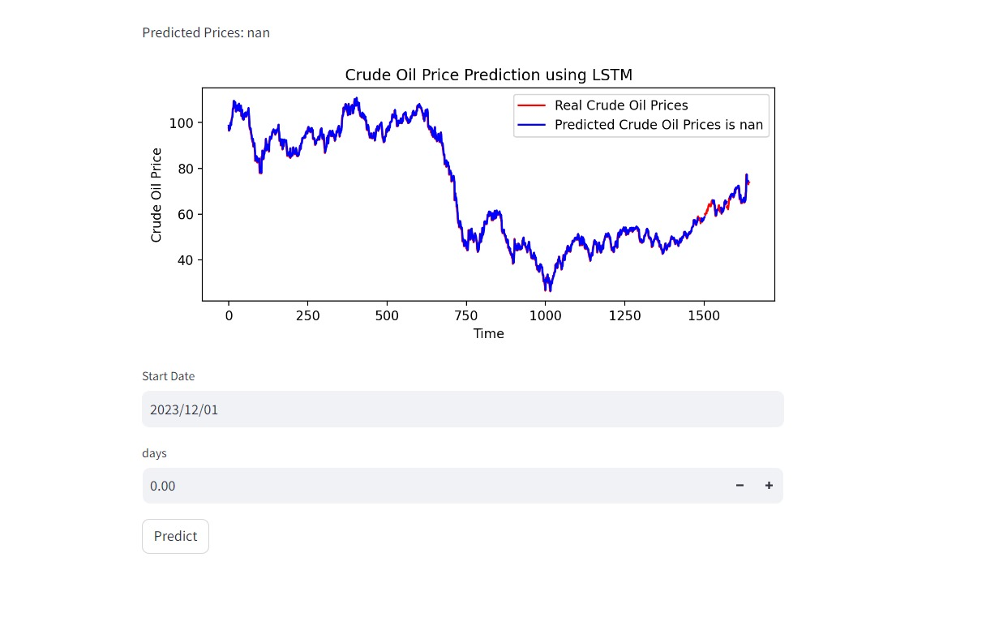
OIL PRICE PREDICTION
LSTM MODEL

Slide 39
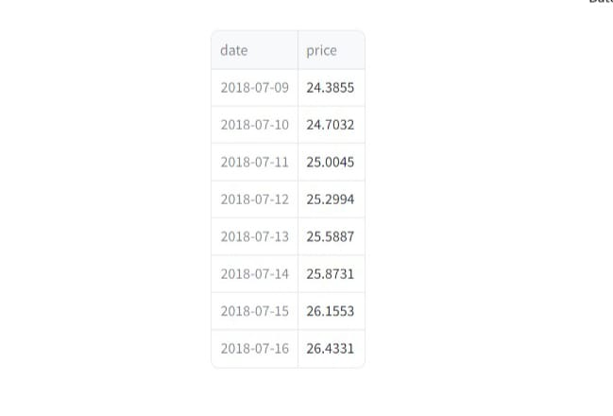

Slide 40
CHALLENGES FACED?
Overfitting and Underfitting the model.
Selection of suitable method for model building.
Model evaluation to check the error.
HOW DID YOU OVERCOME?
Using train-test-split training and testing.
Using 3 – 6 models for selecting the good method which shows minimum RMSE values.
Feature Engineering techniques to evaluate the model.

Slide 41
Conclusion:-
We are all aware today that the oil and gas challenges and threats are constantly evolving. With so much uncertainty and instability, the speed and accuracy of actions and decisions taken to avoid everything new are essential in maintaining the company's stability and progress.
In light Of this, London Premier Centre is honored to offer Oil and Gas Training Courses London, which we advise you to follow to keep yourself informed of everything new in this specialty.

Slide 42
Thank you

